Slide 1
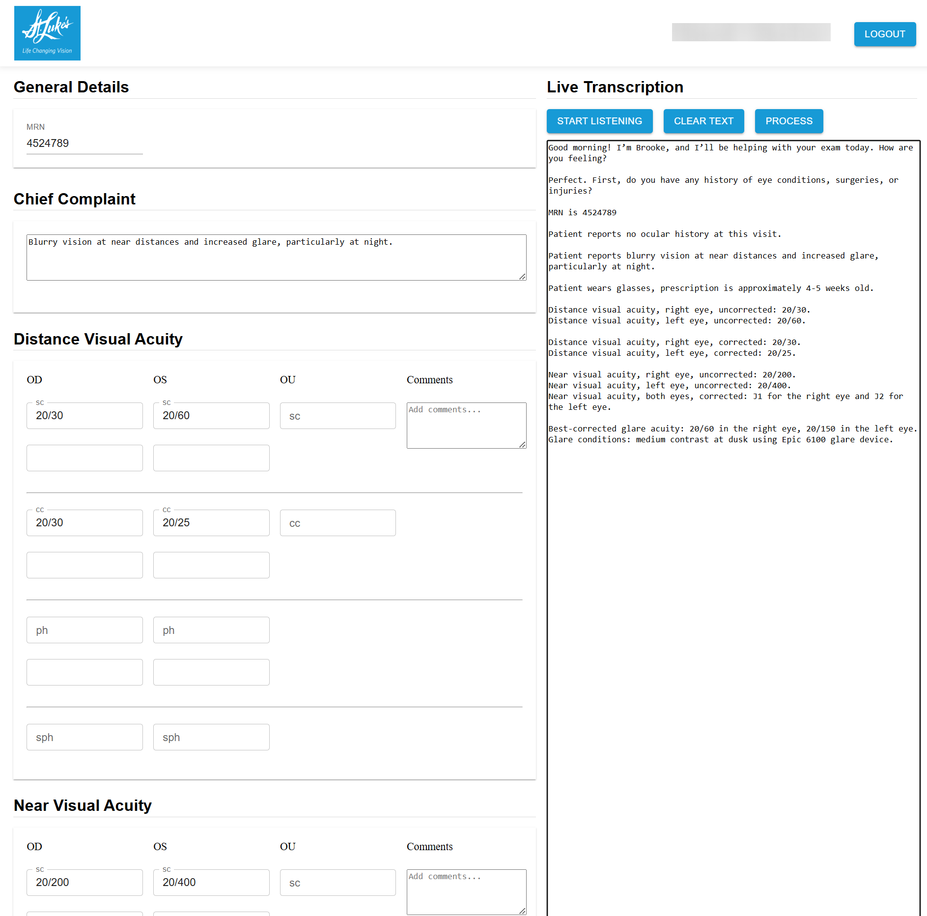
St. Luke’s - Patient Data Capture AI Automation
Business Need
When St. Luke’s optometrists record patient data during exams, details like complaints and test results (Visual Acuity, Refraction, Color Vision, IOP) are written manually, then re-entered into the EMR afterward—causing duplicate work and inefficiency.
What We Did
Affirma built an agentic AI medical scribing solution that captures and structures patient data in real time, reducing manual entry and improving accuracy.​
​
Voice-to-Text Scribing: Real-time voice capture converts optometrist–patient conversations into structured data.​
Agentic AI Processing: Azure OpenAI and ChatGPT models extract key fields like visual acuity, refraction, and chief complaint.​
Automated Interface & EMR Sync: Data populates the UI instantly and syncs to the EMR after review.​
Intuitive Experience: Designed for fast, accurate use during live patient assessments.​
Results
Achieved high data accuracy by eliminating manual data capture and entry processes.​
Significant time savings on administrative tasks, allowing staff to focus on better patient care and schedules.

